Slide 1
Procesarea Limbajului Natural
semantică

Slide 2
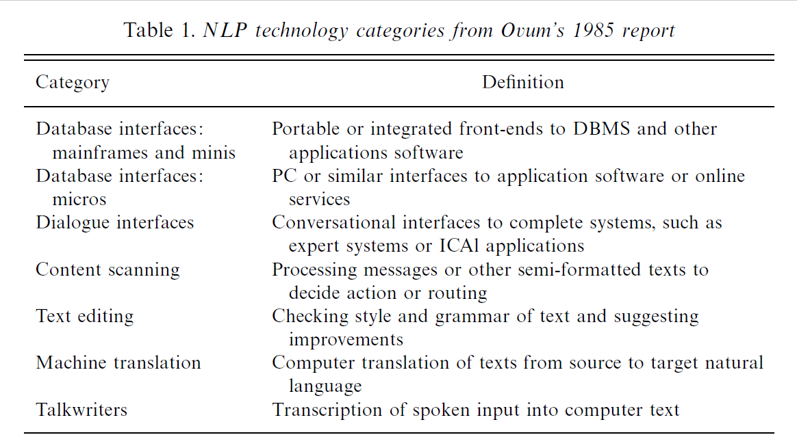
Tehnologiile procesării limbajului natural în 1985

Slide 3



Information Retrieval căutarea informației

Slide 4
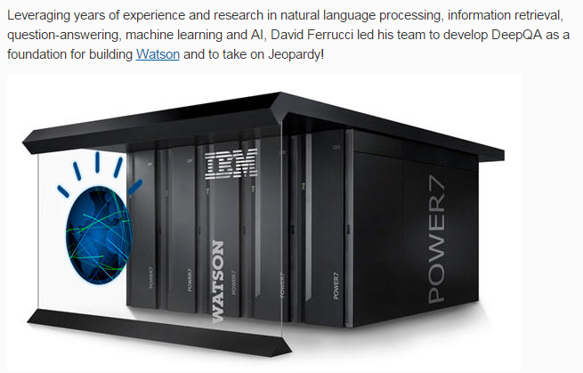
Question Answering Systems sisteme de întrebare-răspuns

Slide 5
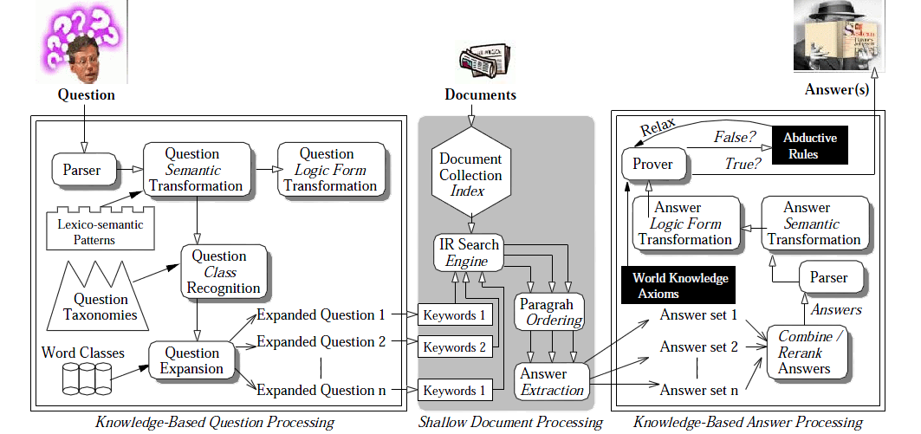
Schema de procesare a întrebărilor și de căutare a răspunsului

Slide 6
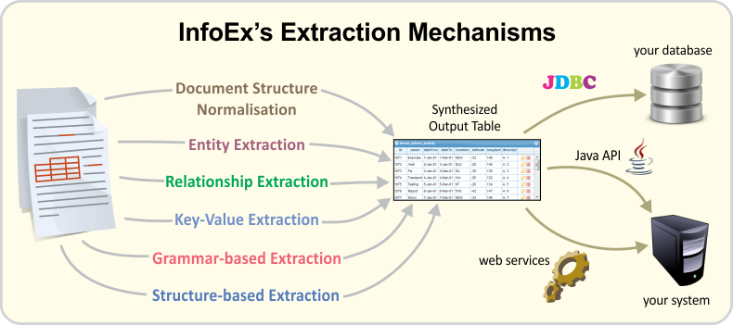
Information Extraction extragerea informației

Slide 7
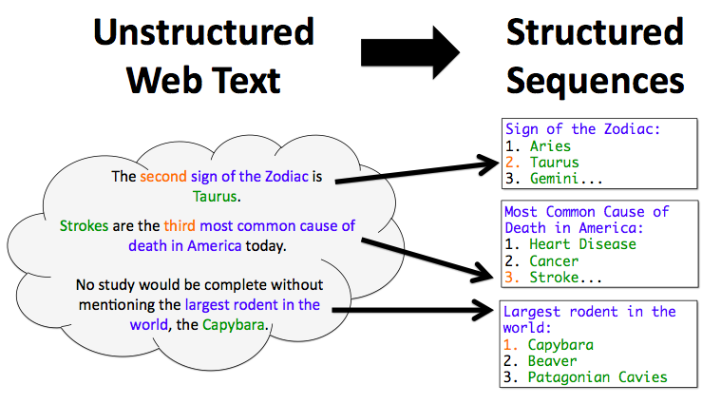
Information Extraction extragerea informației

Slide 8
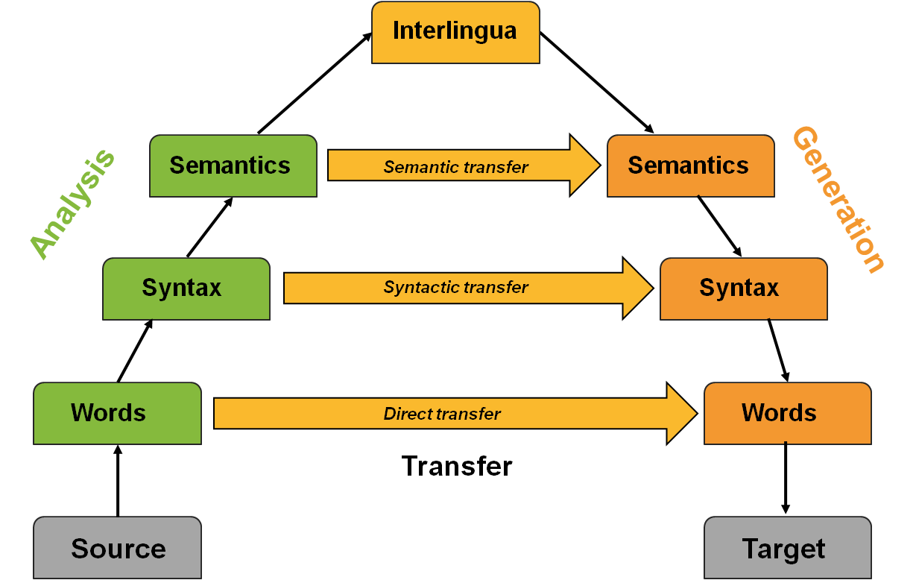
Machine translation traducerea automată

Slide 9

Machine translation traducerea automată

Slide 10
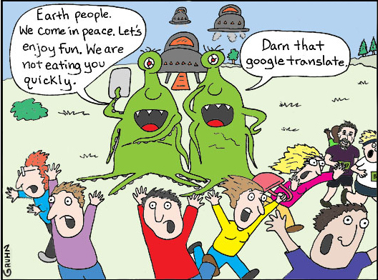
Machine translation traducerea automată

Slide 11
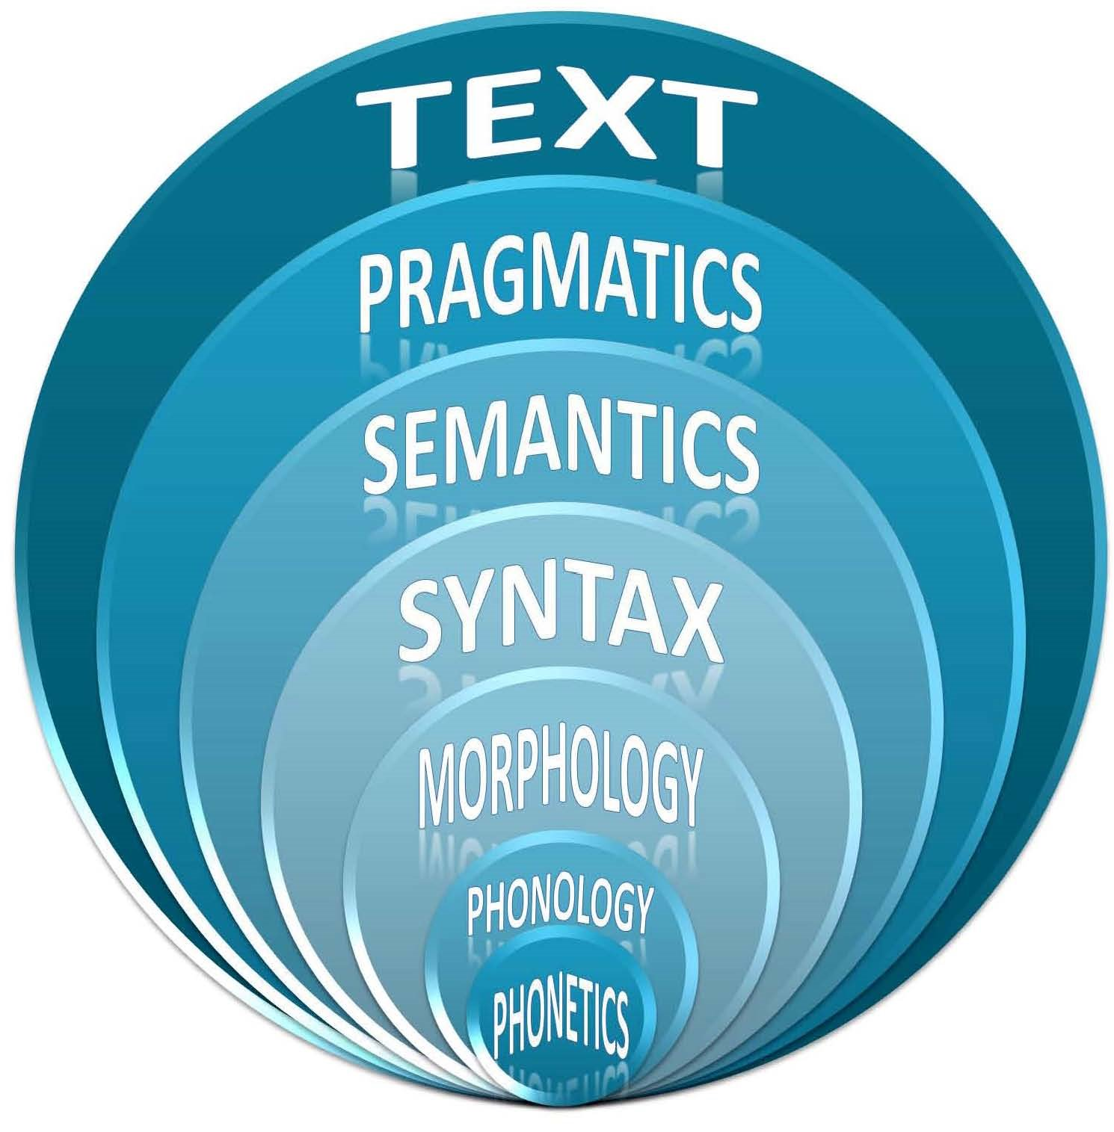
Text Analysis analiza textului

Slide 12

Text Analysis – Data Mining analiza textului

Slide 13
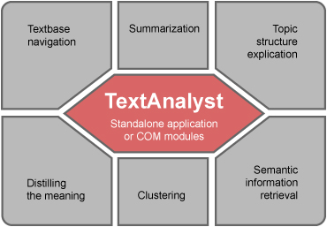
Text Analysis analiza textului

Slide 14
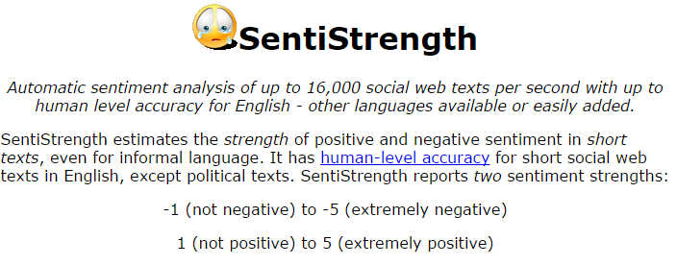
Sentiment analysis analiza sentimentelor
http://sentistrength.wlv.ac.uk/

Slide 15
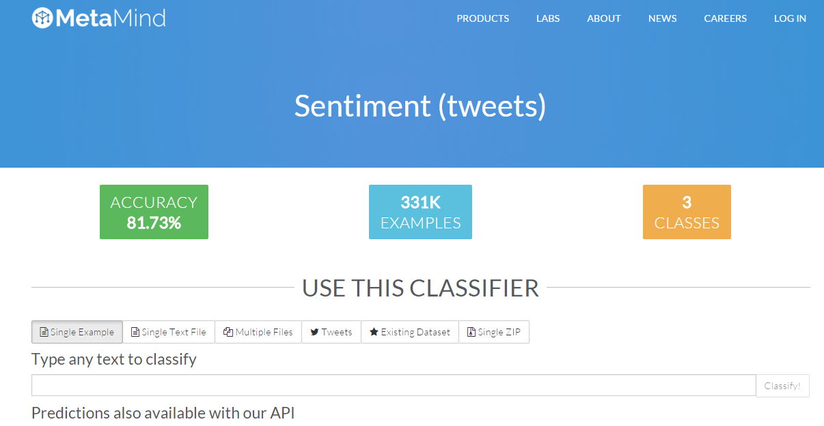
Sentiment analysis analiza sentimentelor
https://www.metamind.io/classifiers/155

Slide 16
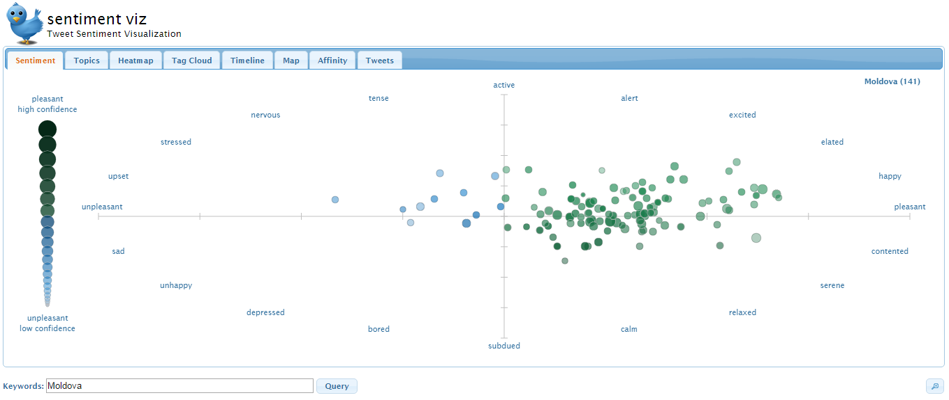
Sentiment analysis analiza sentimentelor
https://www.csc.ncsu.edu/faculty/healey/tweet_viz/tweet_app/

Slide 17

Sentiment analysis analiza sentimentelor
http://blog.datumbox.com/how-to-build-your-own-twitter-sentiment-analysis-tool/
In order to build the Sentiment Analysis tool we will need 2 things:
1) connect on Twitter and search for tweets that contain a particular keyword.
2) evaluate the polarity (positive, negative or neutral) of the tweets based on their words.
For the first task we will use the Twitter REST API 1.1v
and for the second the Datumbox API 1.0v.
You can find the complete PHP code of the Twitter Sentiment Analysis tool on Github.
In order to detect the Sentiment of the tweets we used our Machine Learning framework to build a classifier capable of detecting Positive, Negative and Neutral tweets. Our training set consisted of 1.2 million tweets evenly distributed across the 3 categories.

Slide 18
Google's machine learning Inbox can now reply to your emails
A new feature in Google's Inbox app can recognise the content of emails and tailor responses using natural language, without a human being having to do a thing.
Machine learning is used to scan emails and understand if they need replying to or not, before creating three response options. An email asking about vacation plans, for example, could be replied to with "No plans yet", "I just sent them to you" or "I'm working on them".
The feature, dubbed Smart Reply, is only available in Google's Inbox app for Android and iOS. It has been designed for emails that can be answered with a short reply such as "I'll send it to you" or 'I don't, sorry'.
http://www.wired.co.uk/news/archive/2015-11/03/google-smart-reply-machine-learning-email

Slide 19
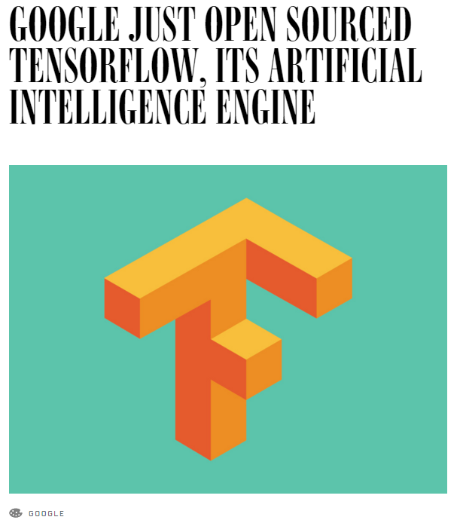
Google is not selling access to its deep learning engine. It’s open sourcing that engine, freely sharing the underlying code with the world at large. This software is called TensorFlow, and in literally giving the technology away, Google believes it can accelerate the evolution of AI.
http://www.wired.com/2015/11/google-open-sources-its-artificial-intelligence-engine/

Slide 20


Conversational system on a robotic platform
We recently bought a humanoid robot and want to port an in-house developed virtual agent on it. Ideal for a student interested in deploying cutting-edge tecnology to a consumer-facing platform.
http://www.xrce.xerox.com/About-XRCE/Internships/Conversational-system-on-a-robotic-platform

Slide 21
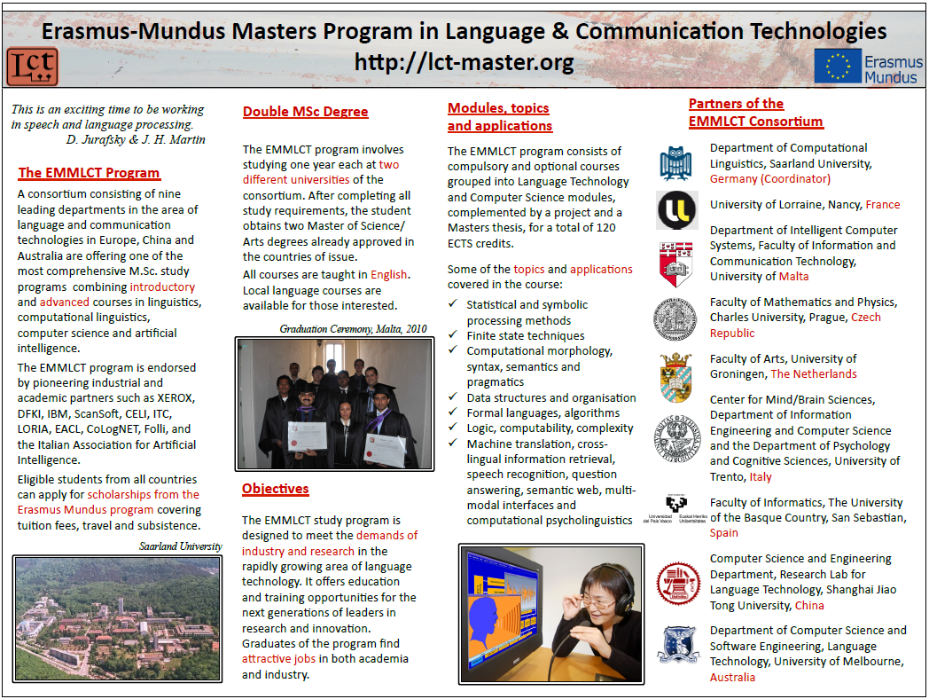

Slide 22
******************************
To prospective Master students
******************************
The Erasmus Mundus Masters Program in Language and Communication Technologies (EMMLCT)
http://lct-master.org
invites applications for Erasmus-Mundus scholarships from both European and non-European students for start in fall 2016.
Key facts:
+ duration 2 years (120 ECTS credits)
+ in-depth instruction in computational linguistics methods and technologies
+ scholarship scheme from the Erasmus Mundus Program of the European Union for EU and non-EU students
+ study one year each at two different partner universities in Europe
+ double degree
+ possibility to visit one of two non-European partners for a part of the study
+ courses and academic and administrative support in English
Deadline for scholarship applications is January 10, 2016.

Slide 23
******************************
To prospective Master students
******************************
The EMMLCT program is offered by the following consortium of Universities:
European partners:
1. Saarland University in Saarbruecken, Germany (coordinator)
2. University of Trento, Trento, Italy
3. University of Malta, Malta
4. University of Lorraine, Nancy, France
5. Charles University, Prague, Czech Republic
6. Rijksuniversiteit Groningen, The Netherlands
7. The University of the Basque Country / Euskal Herriko University, San Sebastian, Spain
Non-European partners:
8. Shanghai Jiao Tong University, China
9. The University of Melbourne, Australia

Slide 24
******************************
To prospective Master students
******************************
The EMMLCT program is offered by the following consortium of Universities:
European partners:
1. Saarland University in Saarbruecken, Germany (coordinator)
2. University of Trento, Trento, Italy
3. University of Malta, Malta
4. University of Lorraine, Nancy, France
5. Charles University, Prague, Czech Republic
6. Rijksuniversiteit Groningen, The Netherlands
7. The University of the Basque Country / Euskal Herriko University, San Sebastian, Spain
Non-European partners:
8. Shanghai Jiao Tong University, China
9. The University of Melbourne, Australia

